Slide 1
xMatters Integration Options
Nov 2014

Slide 2
Agenda
Objective
Integration Flow
Field Mappings
Business Rules
Assumptions
Screen Mockups

Slide 3
Objective
Planned objectives:
xMatters integration for Jira will allow you to create an alert message in xMatters when critical Incidents are detected and reported by a user in Jira
Users will be able to create Incidents from xMatters using the bi directional integration. This will be usefull for scenarios when response team gets a direct call and they create the event directly in xMatters
Once an event is create in xMatters using Jira you can also automatically initiate conference bridges to instantly enable collaboration within your response teams
Complete audit of Incidents and measures taken to resolve in Jira for future reference

Slide 4

Integration Flow (Bi-Directional)
Trigger Event within Jira (Escalation)
Create
New Incident
xMatters
Jira
Create
New Event
Create Incident in Jira within xMatters

Slide 5
Field Mappings (Jira\xMatters)
Jira | xMatters
Solution Group | Solution Team
Product | Product
Priority | Priority
Severity | Severity
xMatters Description | Description
Outage Type | Outage Type
xMatters ID | Jira Incident ID
Note :
Only fields which are common in both the systems and required to create an Event\Incident are listed here
Fields which are highlight with * will be added additional in both the systems
An additional button will be added in xMatters which will be used to create the corresponding incident in Jira and update the Jira Incident ID in xMatters

Slide 6
Business Rules
User should be able to create an Event in xMatters and create the corresponding Incident into Jira and Vice Versa without logging into two separate systems
Refer to the Slide 4 for Field Mappings
The interface between JIRA and xMatters will be two-way integration
The system will pass the JIRA ID assigned to the Ticket back to xMatters for traceability purpose
Once Jira will get response back from event. The Incident ticket get updated and assign to the user(on call user) who has responded to that issue.

Slide 7
Assumptions
In order for bi directional integration to work a user needs to be in VPN to create an Incident in Jira through xMatters
Once an Event is created in xMatters I it will be automatically assigned to the appropriate users\groups based on the solution team selected from Jira. These rules will be created and managed in xMatters
The interface between JIRA and Salesforce will be two-way integration. Integration from xMatters to Jira can done in Phase III after the initial rollout of Jira > xMatters integration
Since xMatter is not integrated with LDAP. All the users will not be in sync between Jira and xMatters
New users will be added by Admin in xMatters manually
We do not have any issues to access the urls from API in xMatters to Jira and vice versa

Slide 8
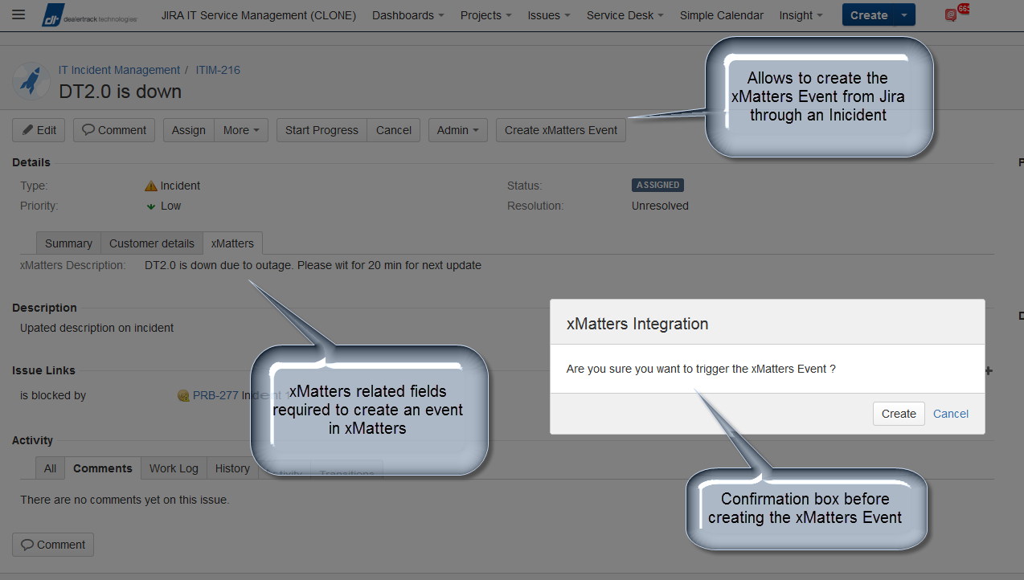
Screenshots (Create xMatters Event from Jira)

Slide 9
Screenshots (Button to create Jira Incident from xMatters)

